Slide 1
Introduction to Servlet

Slide 2
What we cover in this session?
Web sites and its types
Web server responsibilities
Servlet and its role
Servlet container
Servlet API

Slide 3
Websites and its types
Consider a person browse on a website and clicks a link on the page.
In this case…
Website which generate the response at runtime is a dynamic website.
Website which return the same file/data irrespective of who sends the requests is called static website.

Slide 4
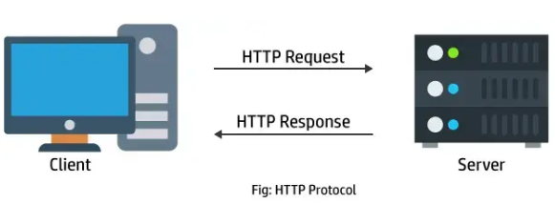
Web server responsibilities
Web server plays an important role in website. It is responsible for receiving the requests from the browser and generates the response and sends the response back to the browser.

Slide 5
Servlet and its role
Web server has two modules. One module is responsible for receiving the requests and it is implemented using low level socket programming.
Other module is responsible for processing requests and generate the responses dynamically. This module is implemented using servlets.
Thus servlet is a server side entity.
Servlet is written in Java.
Servlet runs on web server.

Slide 6
Servlet container
A web server uses a separate module to load and run servlets.
This module is called servlet container.
It manages the life cycle of servlets.
Servlet
Servlet container
Web server

Slide 7
Servlet API
It is a platform independent framework for communication between servlets and servlet container.
It is made up of Java interfaces and classes.
Understanding this Servlet API and using them is essential for servlet programming.

